Slide 1



Key Market Insights for Cab Industry Investments
Virtual Internship
10/10/2024
Submitted By: Mahima Sadananda

Slide 2
Agenda
1. Problem Statement
2. Datasets
3. Analysis and Findings
4. Recommendation
5. Conclusion

Slide 3


PROBLEM STATEMENT
To provide actionable insights to XYZ's Executive team on market trends, customer behaviour, and performance metrics, to determine the best taxi company for investment.

Slide 4

DataSets
Analysis is based on data from 2 cab companies, covering a time period from January 31, 2016, to December 31, 2018. The data is provided in four distinct datasets:
Cab_Data.csv Contains transactional details of rides, including date, company (A or B), distance, cost, and customer ID.
Customer_ID.csv Links customer demographics (gender, age, income) to unique customer IDs.
Transaction_ID.csv Maps transactions to customers and includes payment mode (Credit Card, Cash, etc.).
City.csv Provides city names, population, and the number of cab users for various US cities.

Slide 5
Analysis and FINDINGS

Slide 6
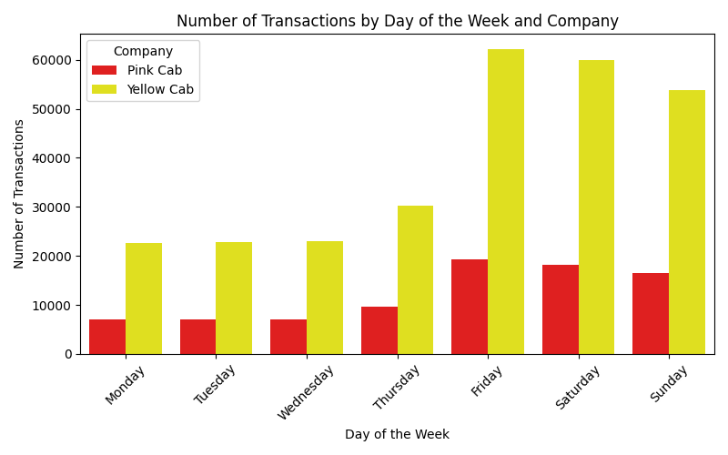
SEASONAL TRENDS
Increased cab demands on Fridays and weekends.
Yellow cab is the preferred company on all days.

Slide 7
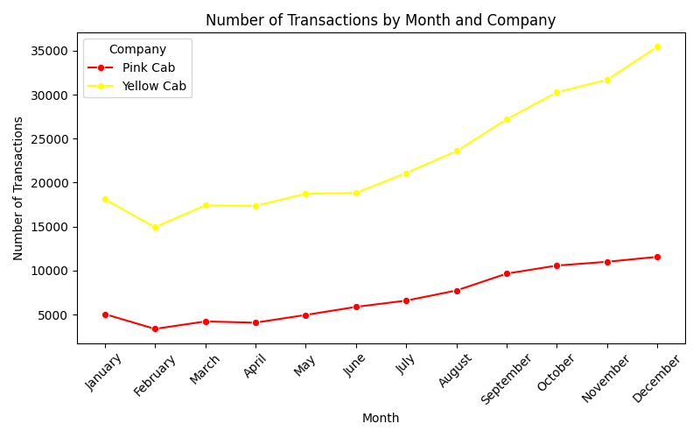
Increased cab demands during rainy and winter months.
Yellow cab is the preferred company across all months.

Slide 8
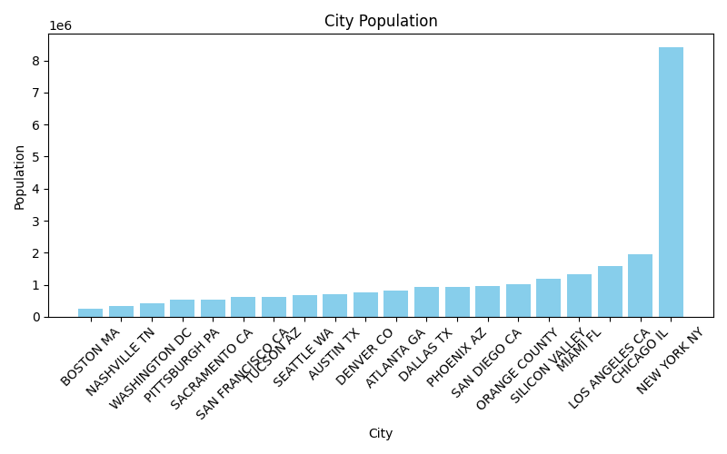
Ride Profit and City Population
New York has the highest population among 20 US states.

Slide 9
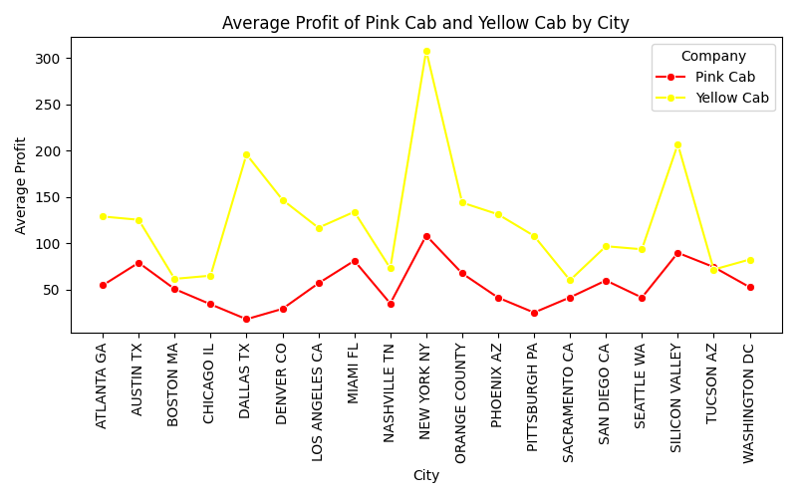
No evident trends in profits based on the size of the city
Yellow Cabs has been making bigger profits in 19/20 cities, highest being in New York.

Slide 10
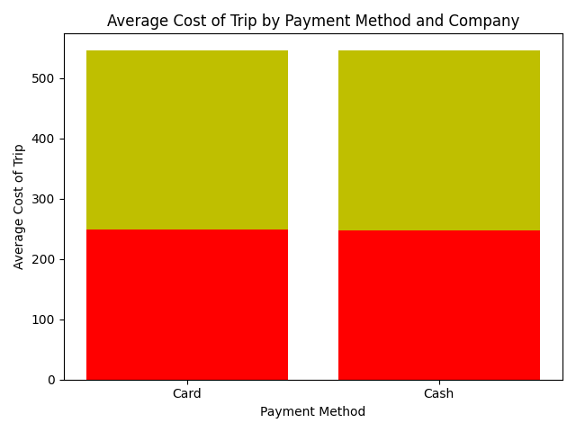
Average Spending and Payment Method
Rider's average spending does not change based on the payment method.
Yellow Cab has overall higher average trip cost.

Slide 11
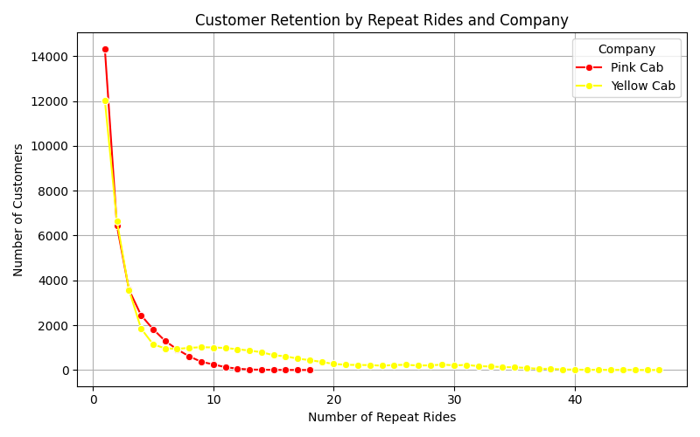
Customer Retention
Pink Cab is the preferred choice for first-time users, showing higher repeat usage up to 7 rides.
Yellow Cab has a greater number of total repeat users, with some customers preferring it for over 40 rides,
No Pink Cab user has ridden more than 18 times.

Slide 12
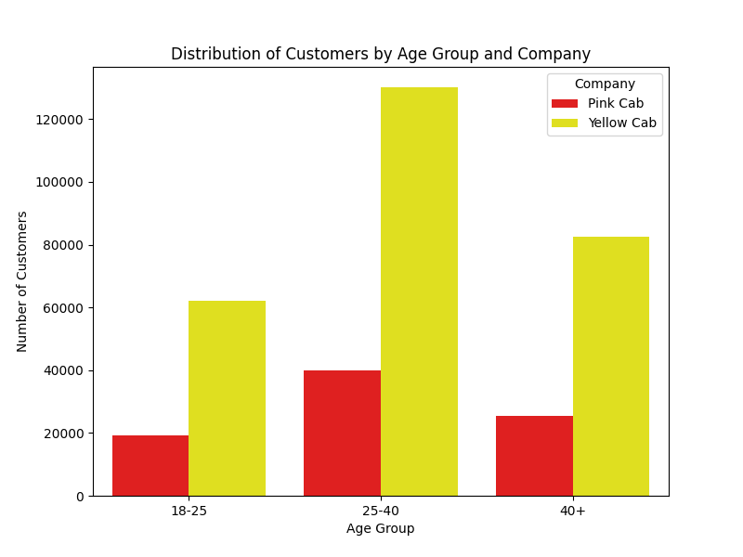
Customer Base
Majorly 25-40 aged users followed by elderly people.
Yellow cabs is the preferred company across all age groups.

Slide 13
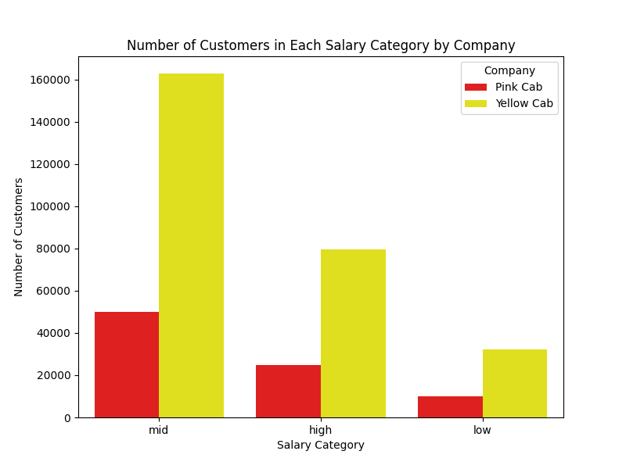
Majorly middle class users.
High income users likely to own a car, while low income users likely to take public transport.
Yellow cabs is the preferred company across all income groups.

Slide 14
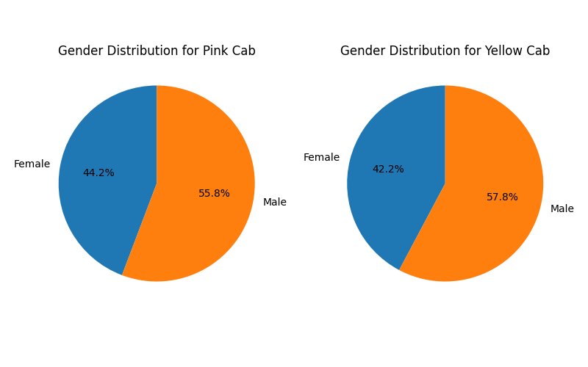
Gender Distribution
Over 50% of the riders are male.
Consistent across both companies.

Slide 15
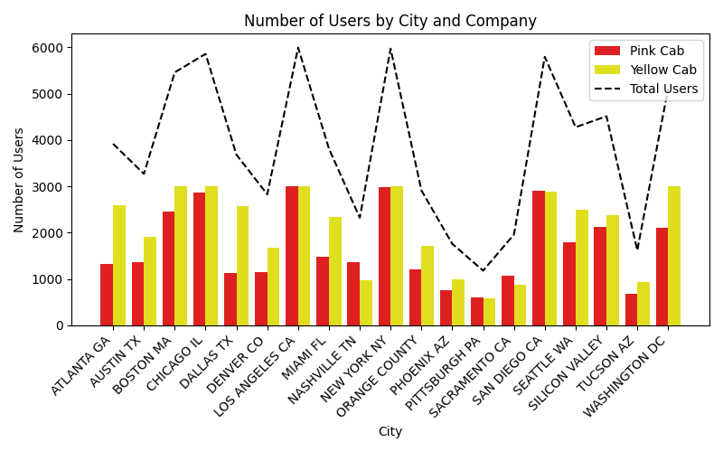
Demographic Distribution
Yellow Cabs is the preferred company in 16/20 cities.

Slide 16
RECOMMENDATION

Slide 17
Based on the findings, Yellow Cab is the better choice for XYZ to invest in.
Customer Preference:
Yellow Cab is preferred in 16 out of 20 cities. This means that in 80% of the cities, more people choose Yellow Cab over the Pink Cab, showing a strong market presence.
Profitability:
Yellow Cab makes higher profits in 19 out of 20 cities. This means that in 95% of the cities, Yellow Cab earns more money. For example, in New York, where the cab market is huge, Yellow Cab is the most profitable.

Slide 18
Higher Trip Cost:
Although both companies have the same average trip cost for cash and card payments, Yellow Cab still has a higher overall average trip cost. This means customers tend to spend more on Yellow Cab rides, increasing their revenue.
Customer Demographics:
Most customers for both companies are middle-class people aged 25-40. Since Yellow Cab is already the preferred choice for a large portion of this group, investing in them will allow XYZ to tap into this steady customer base.
Customer Loyalty:
While Pink Cab attracts first-time users and retains them up to their seventh ride, Yellow Cab has stronger long-term loyalty. Many Yellow Cab users continue riding over 40 times, while no Pink Cab user exceeds 18 rides. This shows that Yellow Cab secures more loyal customers, leading to sustained revenue growth.

Slide 19
CONCLUSION

Slide 20
Yellow Cab is the Best Option.
Investing in Yellow Cab will give XYZ access to a company that is already doing well in most cities and is positioned to continue growing.

